Slide 1

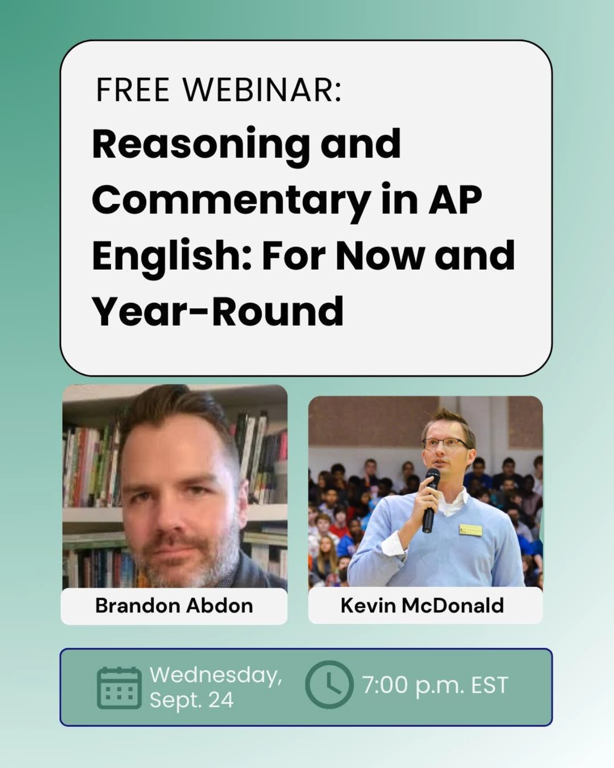
Please drop your name and location in the chat.

Slide 2
Reasoning and Commentary in AP English: For Now and Year-Round
Please drop your name and location in the chat.
Dr. Brandon Abdon & Kevin McDonald
September 24, 2025

Slide 3




Open the chat and respond to this there.
# your responses.
Take your time to think and write.
This is rough-draft thinking, so no pressure.
WHAT DO YOU KNOW?
How do you explain LoR to students?
What are their common misunderstandings or mistakes?

Slide 4

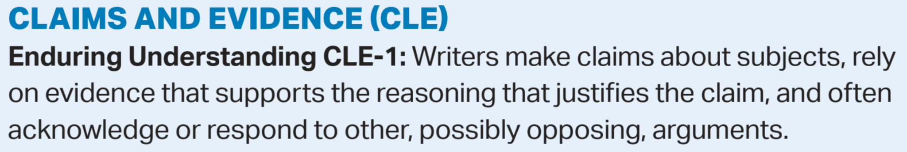


Slide 5
Reasons vs. Reasoning

Slide 6
Reasons & Reasoning
A set of reasons connected through logic and used to reach a conclusion
Reasons and Reasoning are not the same thing
Reasoning is a logical process; thinking
Reasons are explanations, causes, or justifications
Connecting reasons in a logic way that explains how they lead to an interpretation creates a line of reasoning.

Slide 7
Reasons
CLAIM:
School uniforms actually increase inequity and create a troubling atmosphere of uniformity harmful to the development of individuality.
Reason 1: Only students with money will be able to buy enough sets to last a week
Reason 3: Students don’t learn to think independently around peers
Reason 2: No opportunity to express oneself

Slide 8

Line of Reasoning
School uniforms actually increase inequity and create a troubling atmosphere of uniformity harmful to the development of individuality.
School uniforms actually increase inequity and create a troubling atmosphere of uniformity harmful to the development of individuality.
School uniforms actually increase inequity
School supplies one set, but students must buy others
Only students with money will be able to buy enough sets to last a week
Students must constantly clean their uniform or wear it dirty
Peers more likely to notice, tease, and alienate.
create a troubling atmosphere of uniformity
Everyone dresses the same
Troubling because no opportunity to express oneself
Expression helps people learn empathy for those who are different from them
harmful to the development of individuality.
Constant uniformity prevents people from learning to think for themselves
Harmful because students don’t learn to think independently around peers
Independent thinking prevents people from being manipulated.

Slide 9

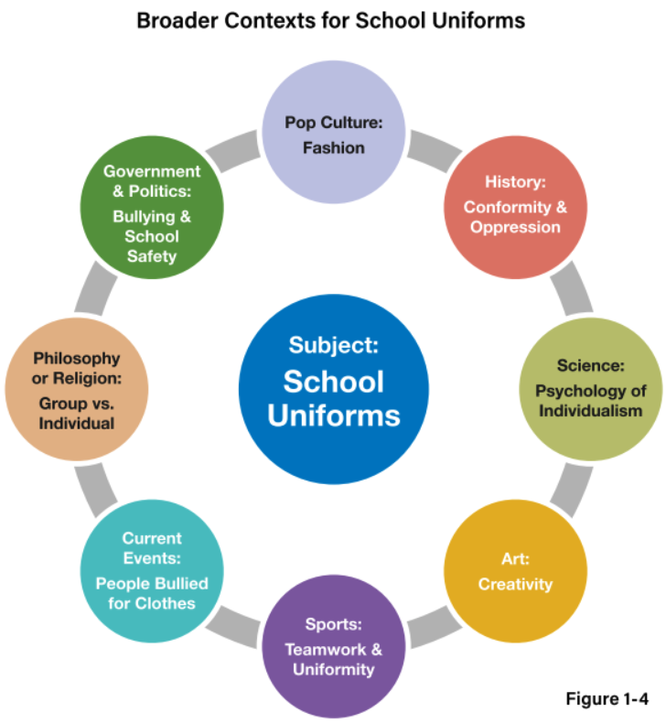
CLAIM:
School uniforms promote teamwork, prevent bullying, and actually make people appreciate their individuality…
Reason 1: promote teamwork
Sports teams work closely together and are united by their uniforms.
Uniforms remind everyone that they have similar goals and should work together and support one another.
Reason 2: prevent bullying
Reason 3: appreciate their individuality

Slide 10

Lines of Reasoning and Logic

Slide 11
Syllogisms and Enthymemes
All humans will die.
Socrates is a human.
Therefore, Socrates will die.
All humans will die.
Therefore, Socrates will die.
School uniforms stifle individuality
∴School uniforms stifle self-confidence.
School uniforms stifle individuality
Individuality is important to self-confidence.
∴School uniforms stifle self-confidence.

Slide 12
The Two Steps to Commentary
(According to the Lang CED)
Commentary - Writers explain their reasoning through commentary that connects chosen evidence to a claim (REO-1.C).
Commentary explains the significance and relevance of evidence in relation to the line of reasoning [thesis] (REO-1.D).

Slide 13
“But that’s what I wrote.”
School uniforms ultimately affect students’ development of self-confidence. They are harmful because of this. They interfere with students becoming more confident in themselves and learning to interact in healthy and productive peer relationships.
School uniforms ultimately affect students’ development of self-confidence. Expressing oneself as unique contributes to the each person’s individuality and that expressions and its acceptance lead to self-confidence. School uniforms are harmful in this way because they interfere with students becoming more confident in themselves and learning to interact in healthy and productive peer relationships.
Students must shift their thinking. They must learn…
That the audience/reader is more important than they are AND
To beware of assumptions about what the audience/reader knows or will understand

Slide 14
Line of Reasoning in Action

Slide 15
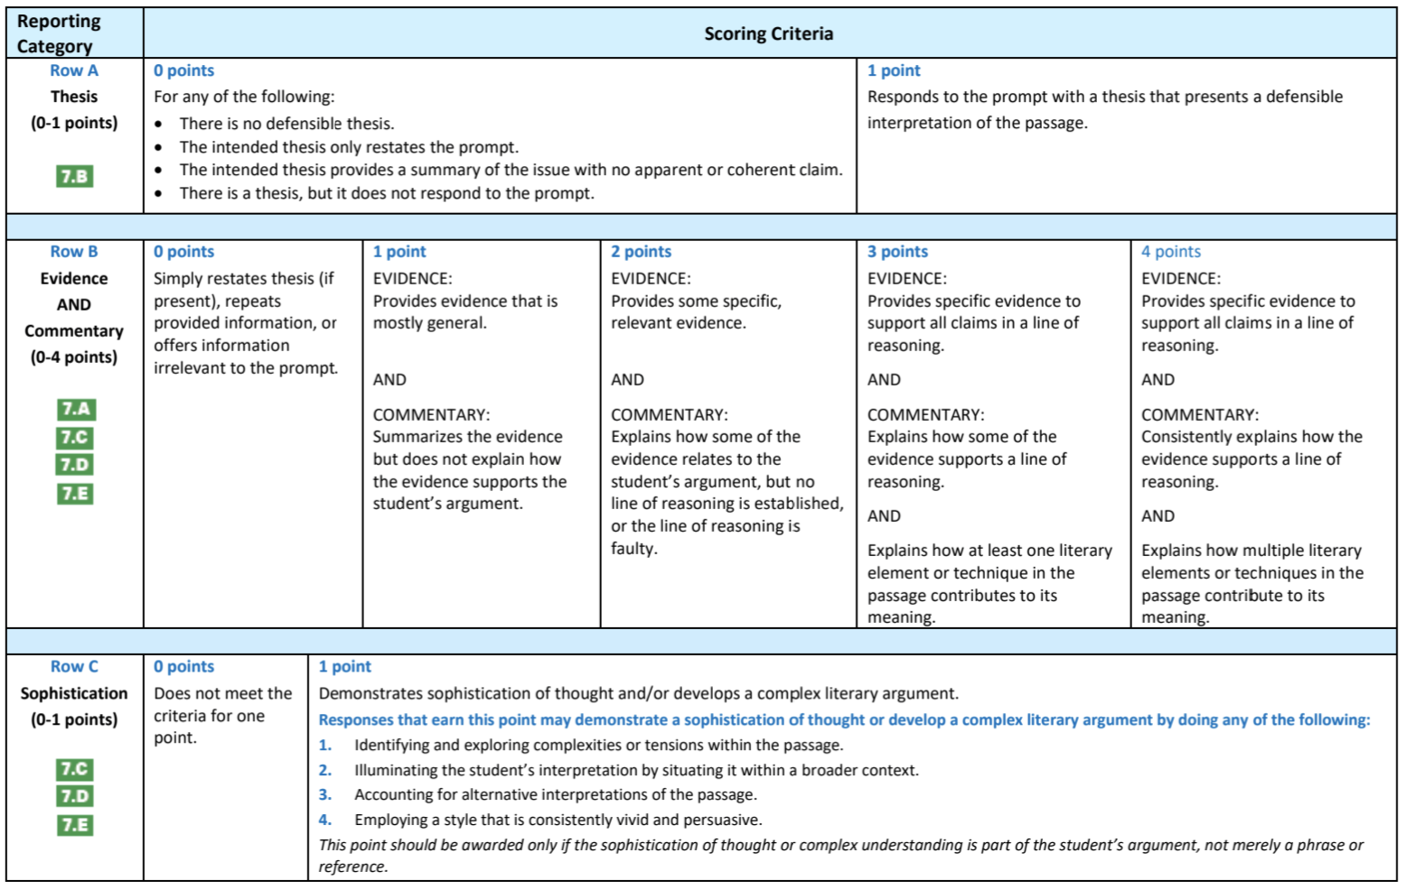

Slide 16
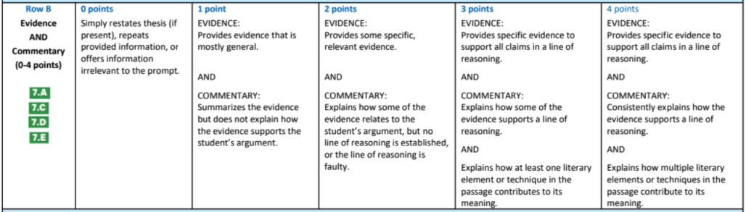
Row B: Evidence and Commentary
Explanation of HOW something relates to an interpretation = commentary.
Evidence is not evidence until it is connected to a claim and commentary.

Slide 17
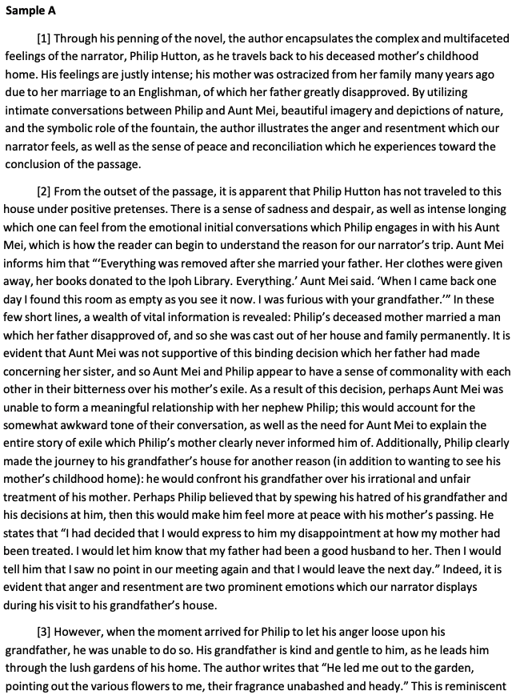
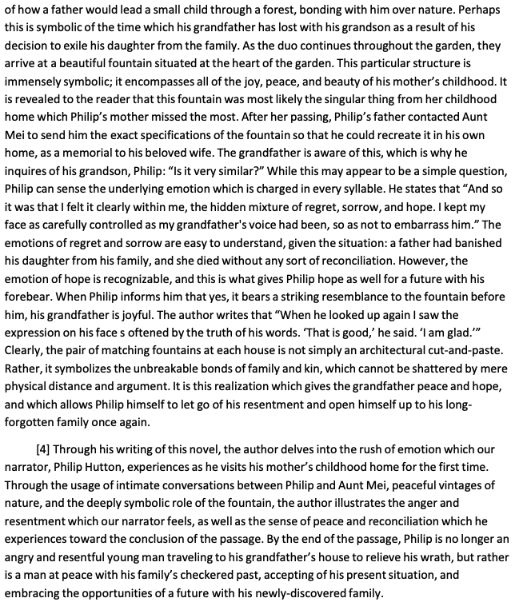
“the essay organizes and supports an argument about the complex and shifting emotions of the narrator, again relying both on specific evidence from the passage and commentary that consistently connects the evidence to the thesis with a line of reasoning that can easily be tracked and understood.”

Slide 18
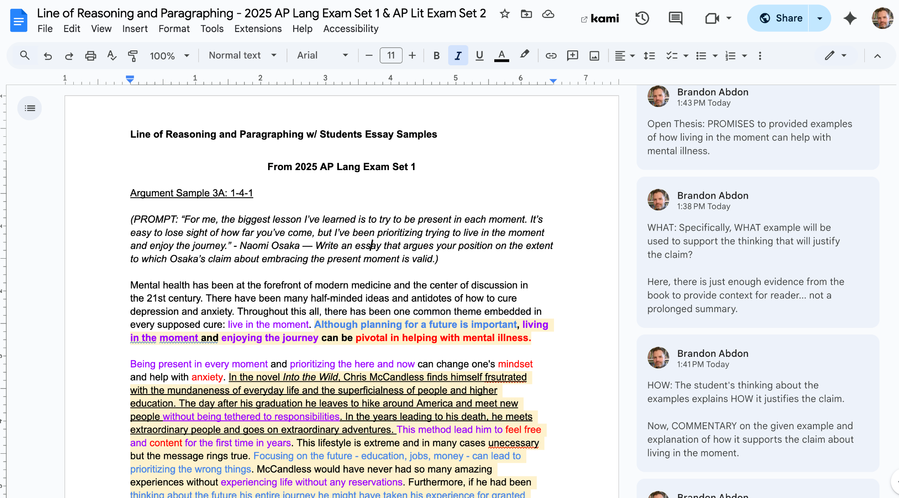
Sample Student Essays [Link Embedded]

Slide 19
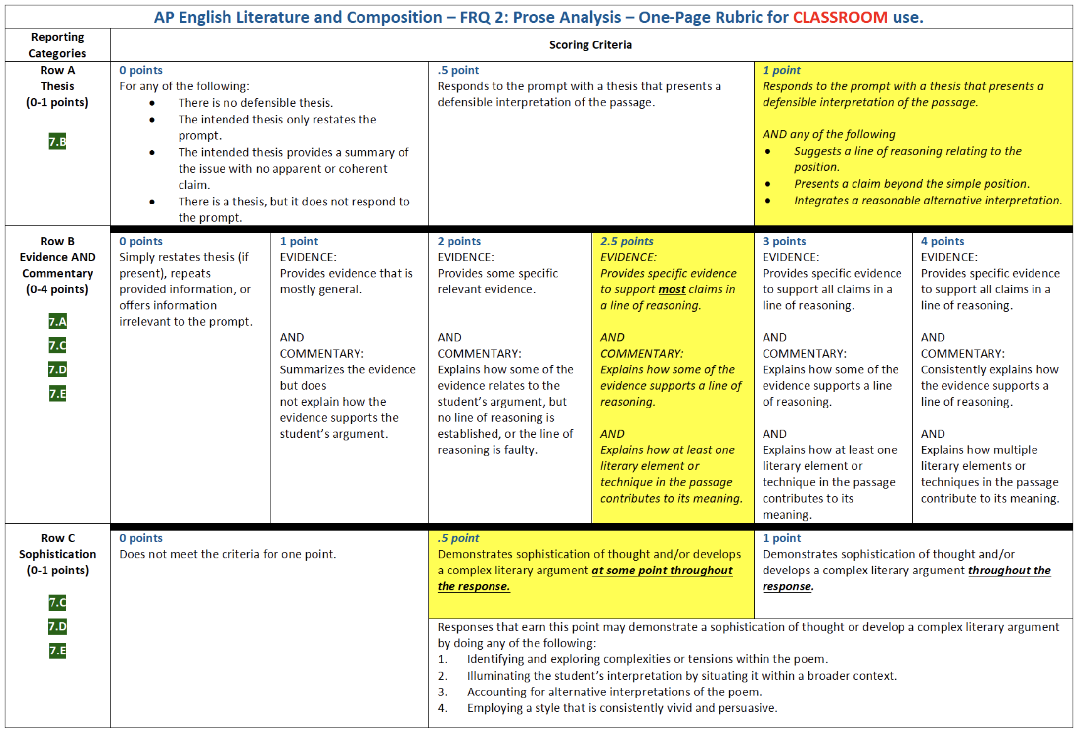

Slide 20
Suggested Activities and Materials
Thesis and Paragraph Highlighting
Abstract Thinking, Reading, and Writing
“Burger Village” Activity for Structure, Evidence, and Commentary
Big Idea and Enduring Understanding Posters for Lang and Lit
“Classroom” Rubrics for Lang and Lit
Cicero’s Six-Part Oration - Organizing an Argument to ensure LoR
Cicero and the Lang Conceptual Framework
Annie Zaleski’s “The loudmouth at the Concert”
Cicero and “The loudmouth at the concert”
Instructions for Imitation Essay/Article

Slide 21
Daily Practice
Sometimes, we send the wrong signals and reinforce bad habits about the thinking process and commentary
Are we identifying and encouraging “Rough Draft Talk”
Are we modeling and expecting students to explain their thinking about their evidence?
Are we modeling and teaching students to connect to bigger ideas and explain those connections?
Are we giving them time to think and write before, during, and after discussions so they learn to see analysis explanation as fluid and evolving?

Slide 22
Final Reflections
What has challenged you?
What are you thinking about changing now?
How might you revise your approach?
What is problematic?
Take time to reflect on what we have explored here today.

Slide 23
FAQs and Qs from U

Slide 24
We are risk takers and mistake makers
(thanks Andy)

Slide 25






Our Partners
Notes:
https://appliedpractice.com/mock-exam-information-request-goe/

Slide 26
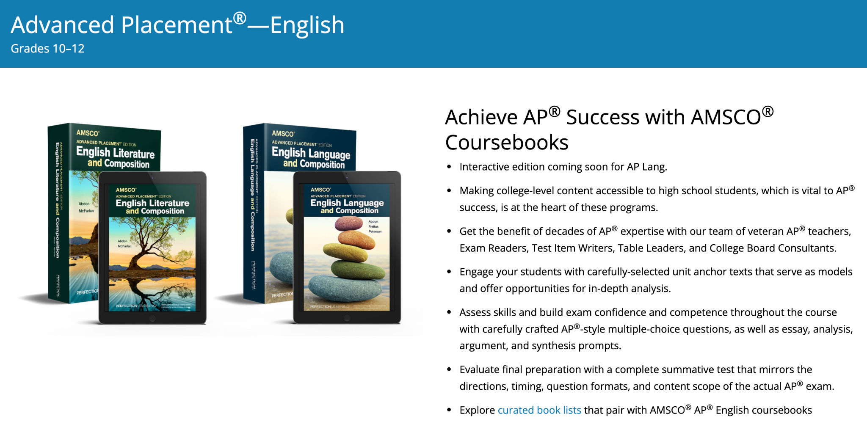
Notes:
https://www.perfectionlearning.com/high-school/high-school-literacy/advanced-placement-english.html

Slide 27


Please be in touch
Brandon.Abdon@gmail.com
kmac_aplang@mac.com
Notes:
https://muchadoaboutteaching.com/the-ap-exam-behind-the-scenes/

